Slide 1
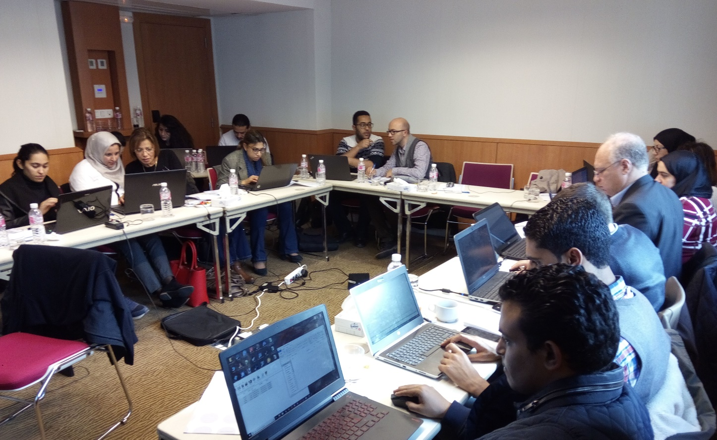
Engaging local stakeholders: Tunisia case
Scope: Informing National Energy Plans and electricity utility strategies on options for high renewable penetration and energy independence
Modules: Electricity (to be extended), economy
Spatial scale: Modelled also individual power plants and their techno-economic characteristics
Temporal scale: Year divided in 108 time slices

Slide 2
Energy and the economy (recalling Lec. 3)
Changes in energy prices, demands, investments and technological chains have effects on whole economy. Different ways to assess these, e.g.:
Compute investment needs, job creation, etc. from outcomes of energy model, using ‘multipliers’
Model effects on whole economy, e.g. using CGE models
Reference: Dhakouani et al., Energy, 2017
1

Slide 3
Engaging local stakeholders: Tunisia case
Challenges:
Different actors want different types of information out of the model. Not all can be said.
Models need to be transferred to a local consortium. Effort successful only if they can reproduce them.
Priorities of the actors and the Government keep changing.

Slide 4
Engaging local stakeholders: Tunisia case
Solutions?

